Slide 1
ENSE 374, Milestone 3
Space Minds
Anupras Burokas, Ahras Ali, Jack Zhao
Wednesday, Nov. 13

Slide 2
Project blurb & MVP 1 demo
We are building a NASA imitation console that educates and inspires young minds about the technological advances of space exploration.
Was your team successful in mapping out your envisioned MVP-1?
Yes, we accomplished about 87% of our MVP-1
We wanted to have the docking function accomplished, but due to time constraints we moved it to our final milestone
Do you consider your code clean?
Our code is clean since we wrote/refactored it while following the “Quality variables” lecture notes
In addition, since this is a hardware-oriented project, we made sure that our wiring is also clean and tidy (example in a bit)

Slide 3
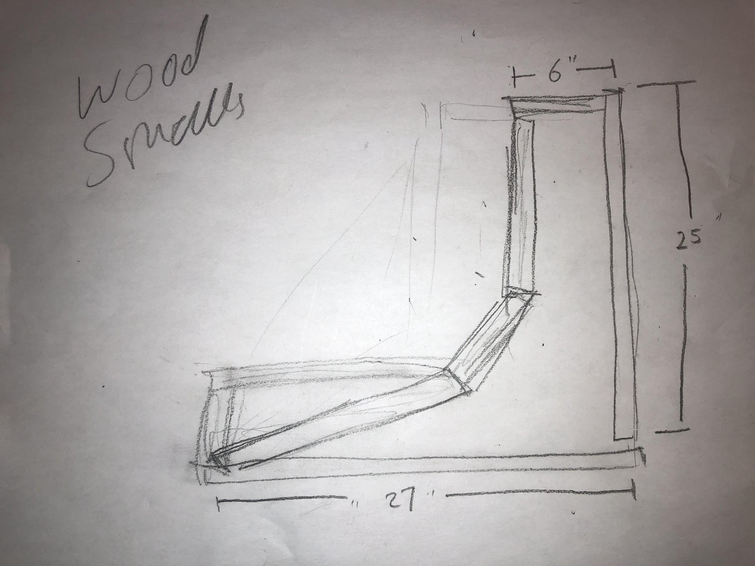
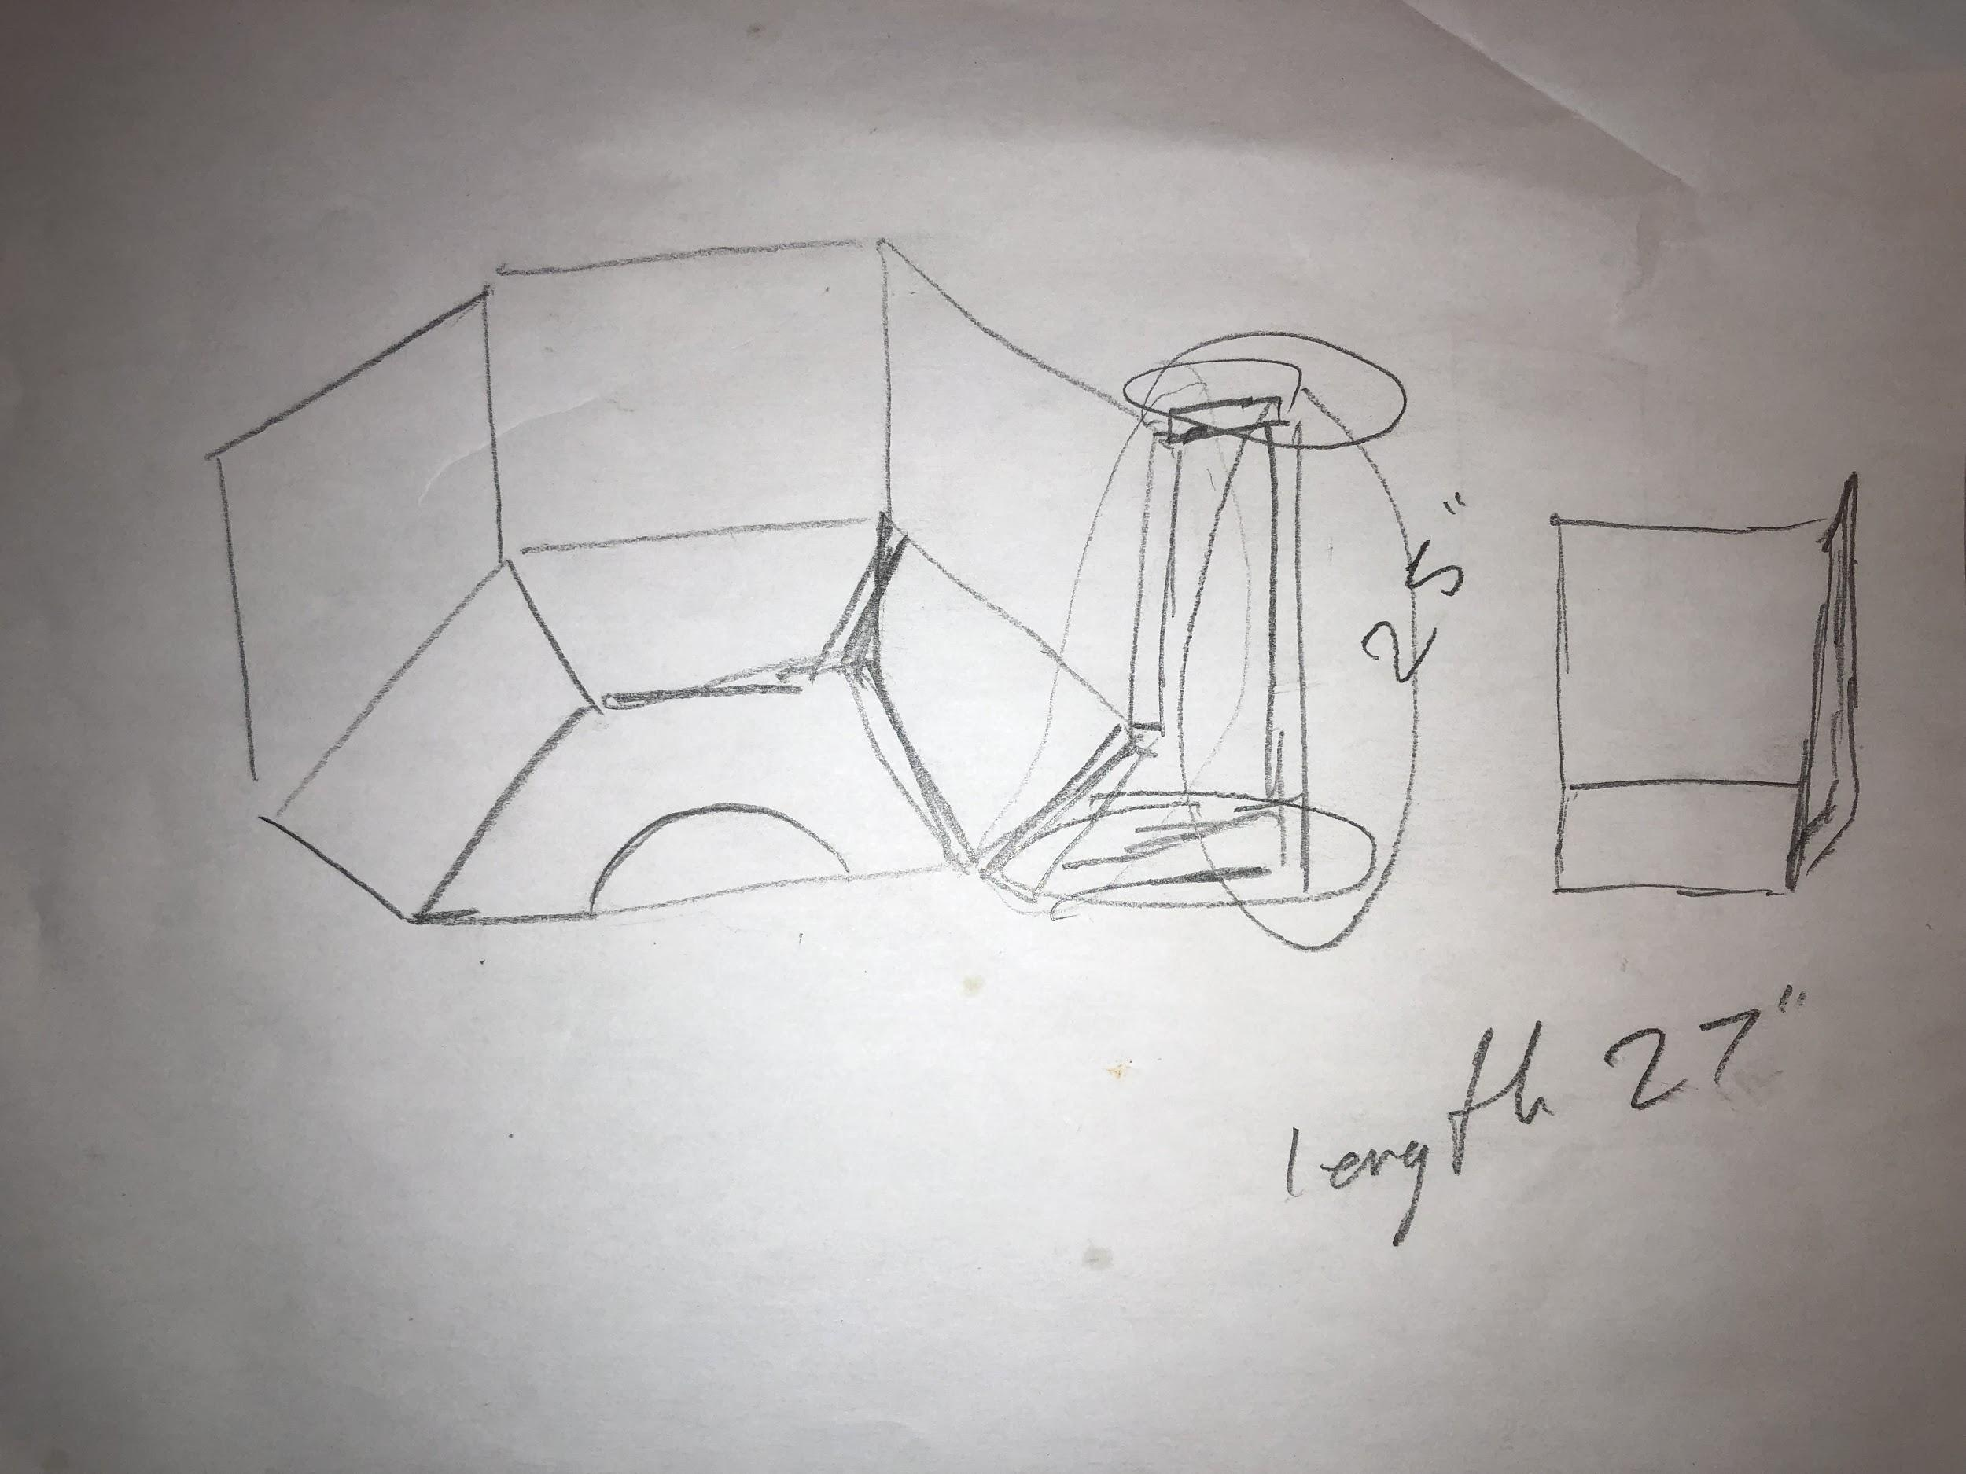
Sketch of center console →
← Sketch of updated console layout

Slide 4
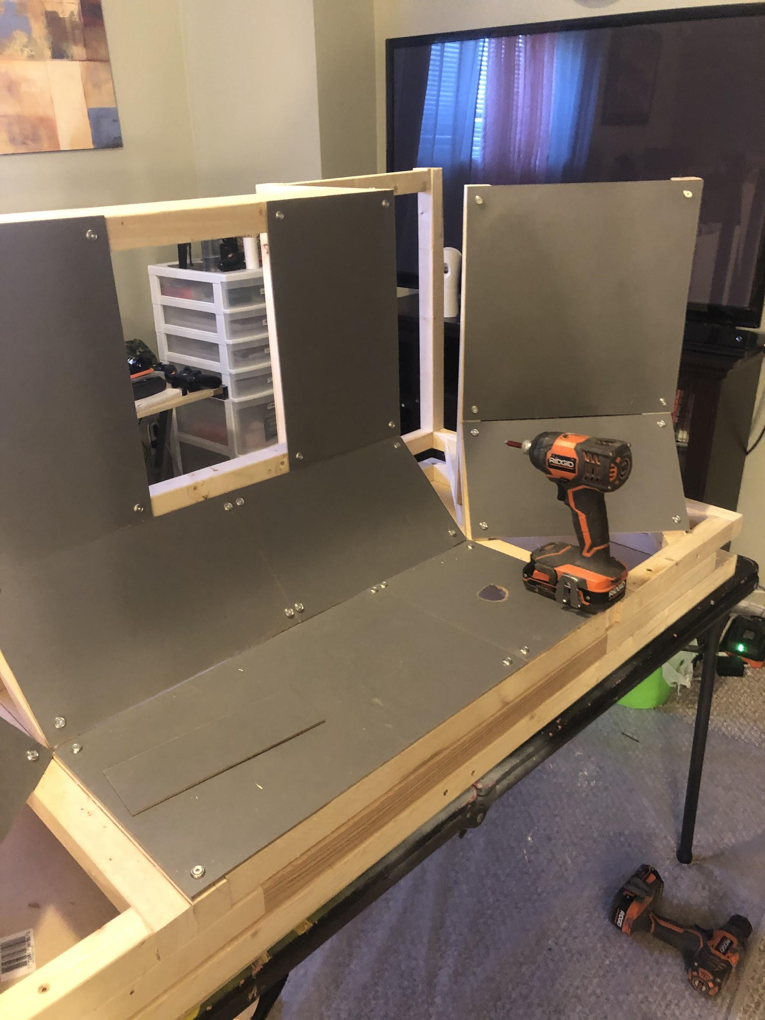
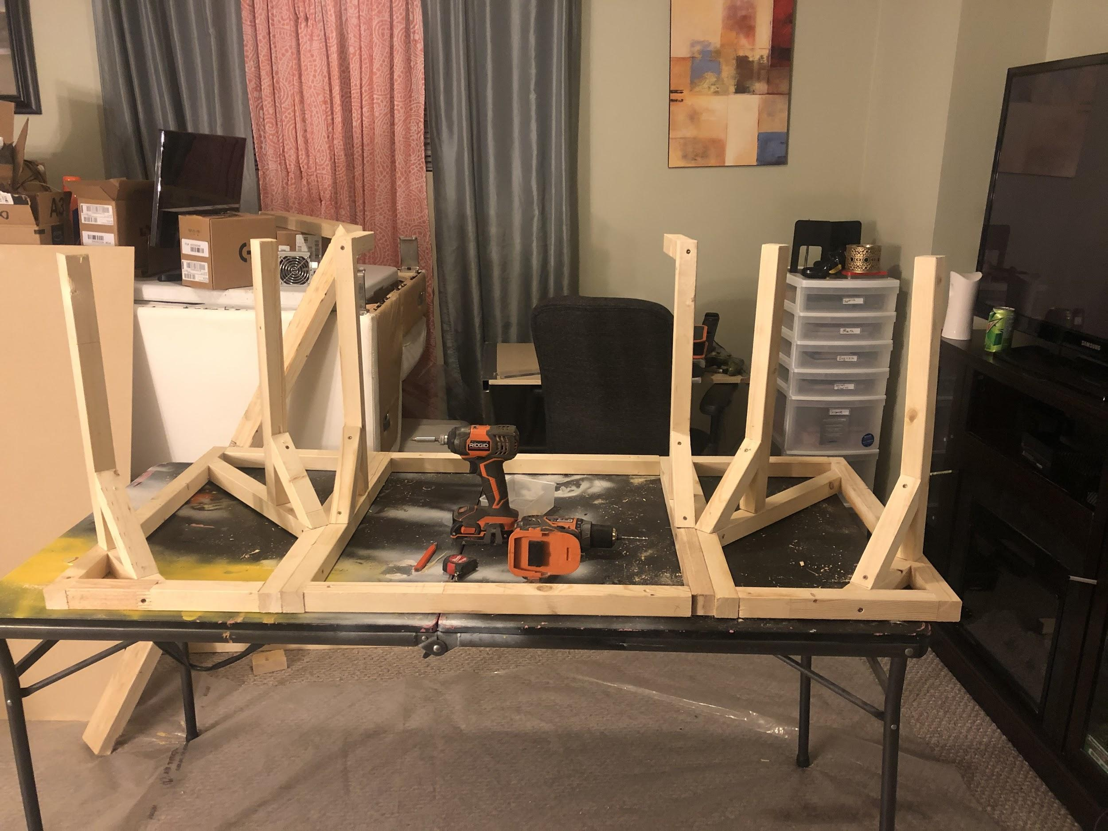

Slide 5
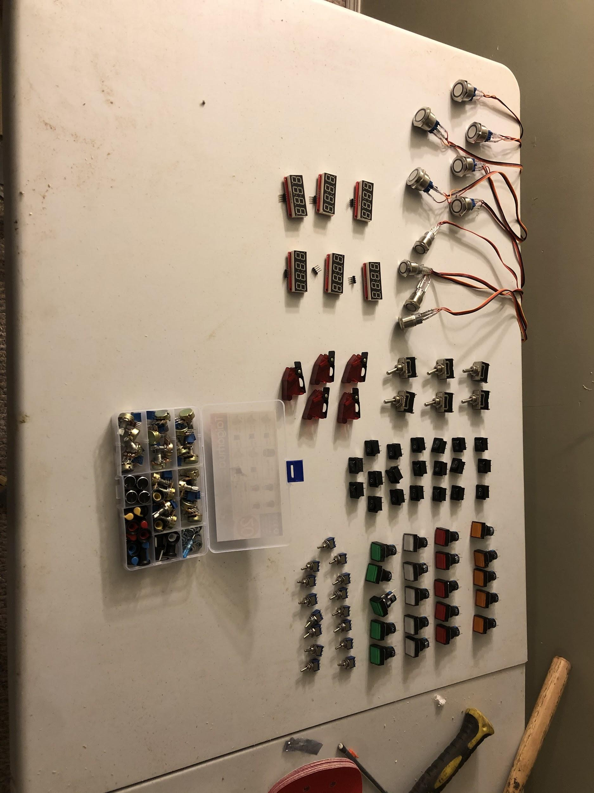
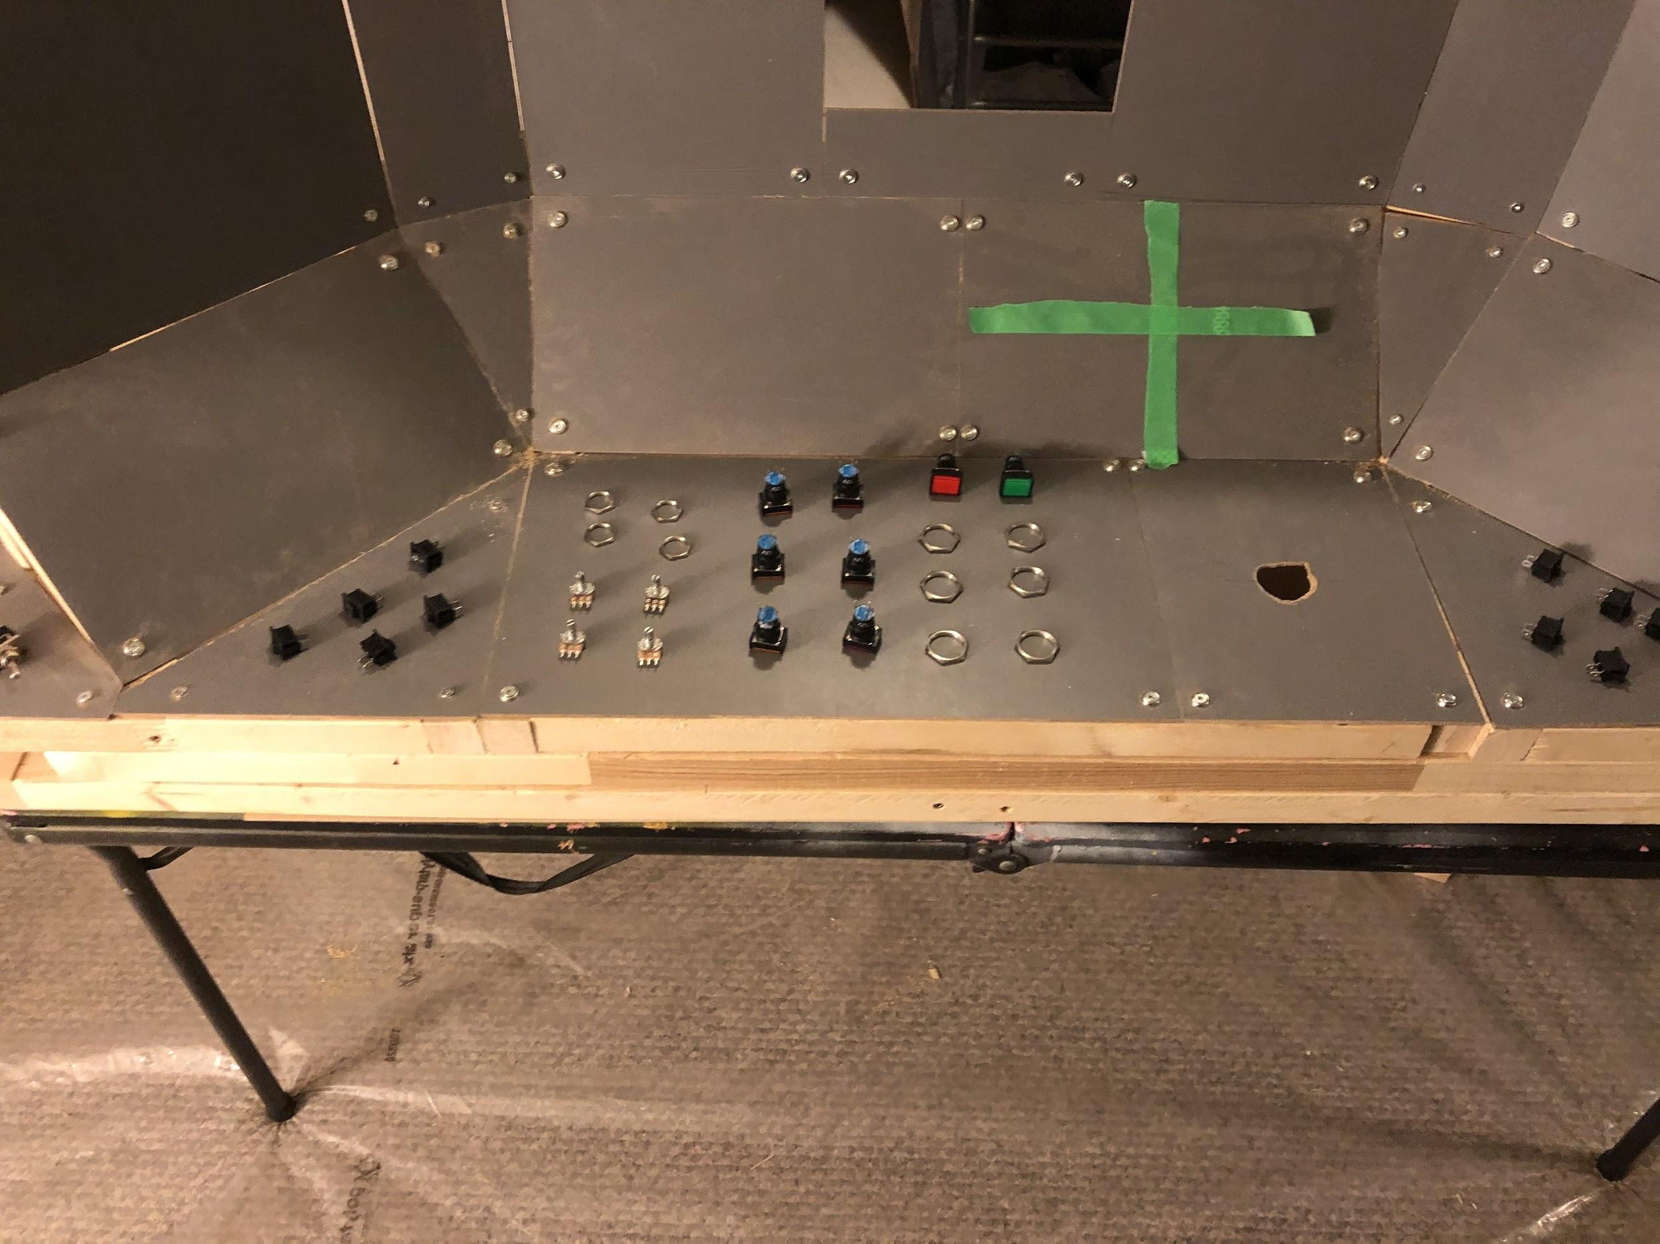

Slide 6
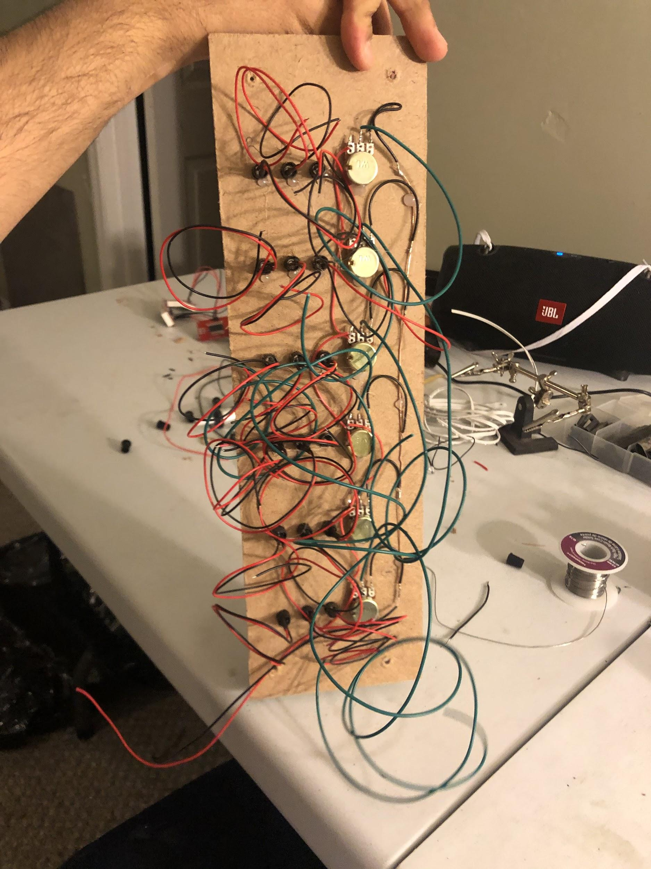
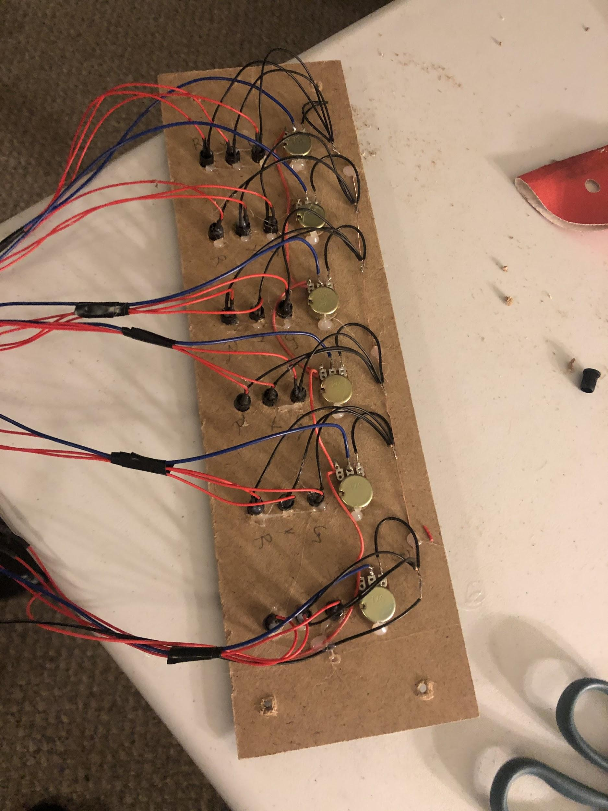
Before →
← After

Slide 7
Demo Video
CLICK ME

Slide 8
Construction & development changes
In our functional requirements document, we updated the user requirements as well as the functional requirements
Illustrate your updated Kanban (in GitHub)
Moved around some stuff (in-progress → done)
Added the code and resources (videos & sounds)
For changes to the design, we decided to make the frame of our project larger to spread out the layout of buttons

Slide 9
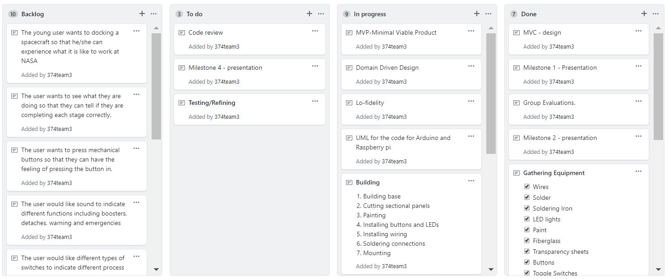

Slide 10
MVP-2 & GitHub
For our last MVP, we plan to:
Wire and code everything together (switches, LED’s, buttons, etc.), have everything labeled, fill any remaining gaps in the structure, and make some final touches (paint, wires, etc.)
Review your team’s GitHub
Added new tasks to the “To do” pane
Completed tasks were moved to the “Done” pane
Uploaded the code, code review doc, demo videos, and any sound files we have used
Updated/Evolved user stories

Slide 11
Group reflection
How did you feel about this milestone? What did you like about it? What did you dislike?
We liked the actual hardware building part of the project, which helped us get a more visual understanding of how everything fits together in the project
Wiring everything together was fun (though confusing and taxing at times)
What did you learn about yourself as you collaborated and worked through this milestone?
Spend time more efficiently
Allocate more time for coding (this is our first time coding with Arduino and Raspberry PI, so we are still getting the hang of it)
How will you use what you have learned going forward?
Don’t reinvent the wheel
Chance is, someone has already created an (opensource) library with the functions you need

Slide 12
Any questions?

